Slide 1

Formation of protein self assembled monolayer monitored by Quartz Crystal Micro-balance
S.S.A. Shah Bukhari, Md Ramjan Ali and Sachin Raj Pandey
02.01.2023

Slide 2

Overview
1. Piezoelectric effect
2. Resonator
3. Mass deposition and sensitivity
4. Experimental setup
5. Data analysis and results
6. Conclusion
7. Application

Slide 3
Piezoelectric effect
Conversion of mechanical energy to electrical energy or electrical energy to mechanical energy
Mechanical or electrical stress causes crystal deformation
Crystal deformation gives voltage or vibration

Slide 4

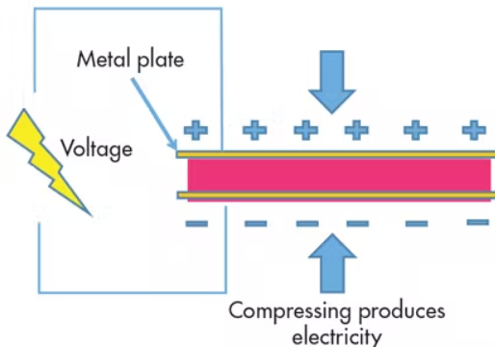

Forward Piezoelectric Effect
$\vec{P}$= e$\vec{x}$
Crystal
Mechanical Pressure is applied on crystal by metal plates
Electric charge got separated due to the crystal out of balance
Charge separation gives voltage
Source:https://www.electronicdesigncom/power-management/article/21801833/what-is-the-piezoelectric-effect, https://www.autodesk.com/products/fusion-360/blog/piezoelectricity/

Slide 5
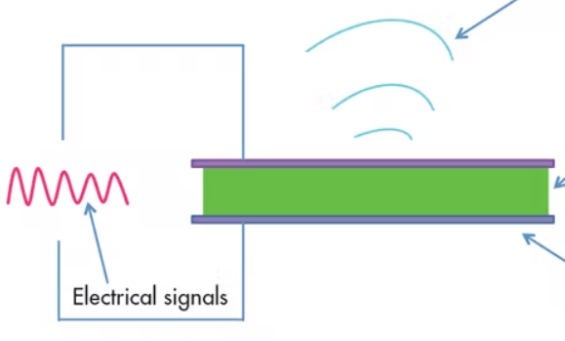

Reverse Piezoelectric Effect
$\vec{x}$= d$\vec{E}$
wave
Electrical energy is applied to the crystal
Crystal got expanded or contracted due to E-field which gives a shear deformation
Electrical energy converts to mechanical energy as a form of vibration
Crystal
Metal plate(Gold)
Example: Lead zirconate titanate (PZT), Barium titanateate,Gallium nitride and Zincoxide
Source:https://www.electronicdesigncom/power-management/article/21801833/what-is-the-piezoelectric-effect, https://www.autodesk.com/products/fusion-360/blog/piezoelectricity/

Slide 6
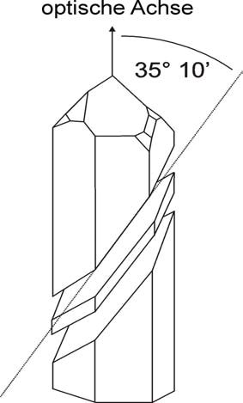
Resonator
A
AT- cut quartz crystal used in the QCM experiment with
an angle of 35.10°(A)
Temperature coefficient is nearly 0 for AT-cut crystal, so remain stable between 0-50°C temperature
Source: https://wiki.physik.fu-berlin.de/fp/_media/private:ma17.pdf

Slide 7
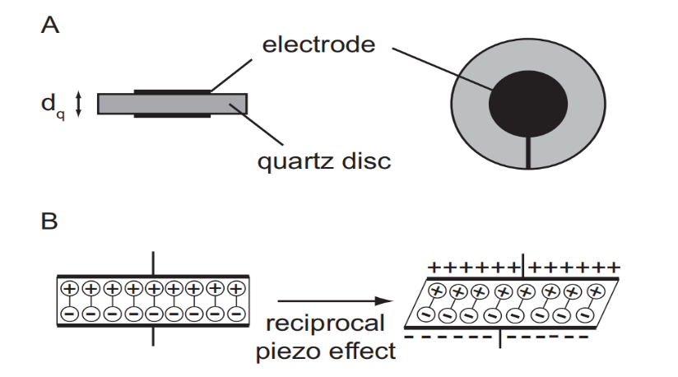
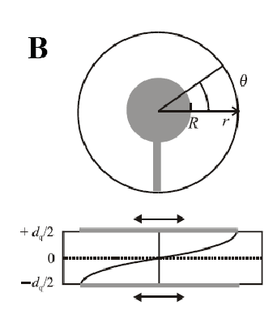

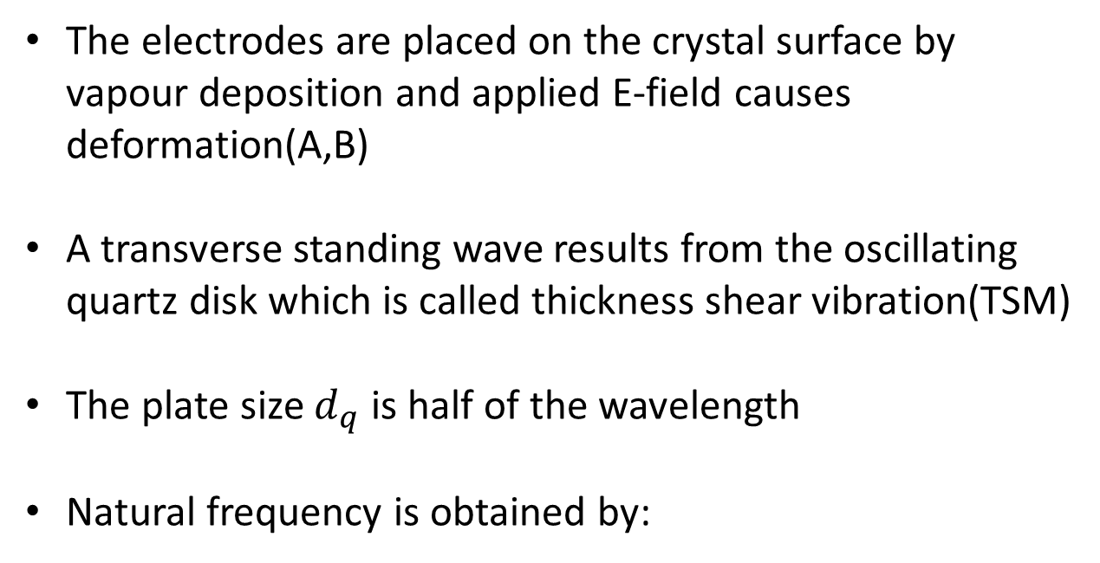
Resonator
The electrodes are placed on the crystal surface by vapour deposition and applied E-field causes deformation(A,B)
A transverse standing wave results from the oscillating quartz disk which is called thickness shear vibration(TSM)
The plate size $d_{q}$ is half of the wavelength
Natural frequency is obtained by:
f = $\frac{{nk}_{R}}{d_{q}}$
Source: https://wiki.physik.fu-berlin.de/fp/_media/private:ma17.pdf

Slide 8
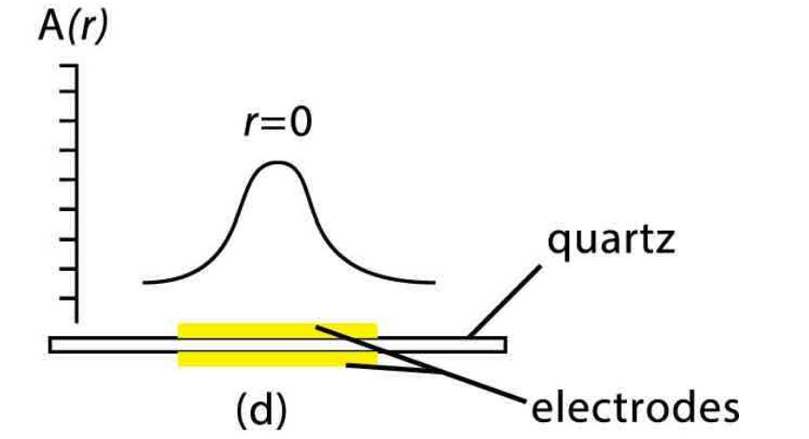
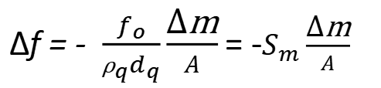
Mass deposition and sensitivity
∆f = - $\frac{f_{o}}{{\text{ρ}}_{q}d_{q}}\frac{\text{∆}\text{m}}{A}$ = -$S_{m}\frac{\text{∆}\text{m}}{A}$
The effect of rigid mass deposition on the crystal and changes of oscillation is described by Sauerbrey equation[1952]
Resonance frequency of the quartz decreases with increasing mass on it and so on
Applicable to deposited mass less than 0.5% of the mass of the quartz crystal
Source: https://wiki.physik.fu-berlin.de/fp/_media/private:ma17.pdf, https://www.nanoscience.com/techniques/quartz-crystal-microbalance/

Slide 9
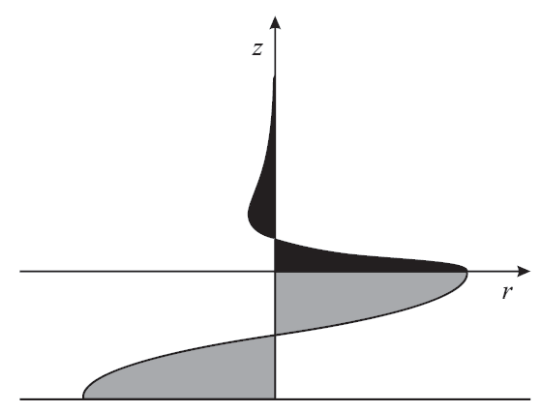
Mass deposition and sensitivity
Why Sauerbrey equation is not valid in liquids?
The maximum displacement of the shear transverse wave of the oscillating quartz(grey area) in air or vacuum
Shear wave got damped in liquid
Damping depends on density and viscosity of the liquid; the more the density and viscosity, the more the damping
Source: https://wiki.physik.fu-berlin.de/fp/_media/private:ma17.pdf

Slide 10
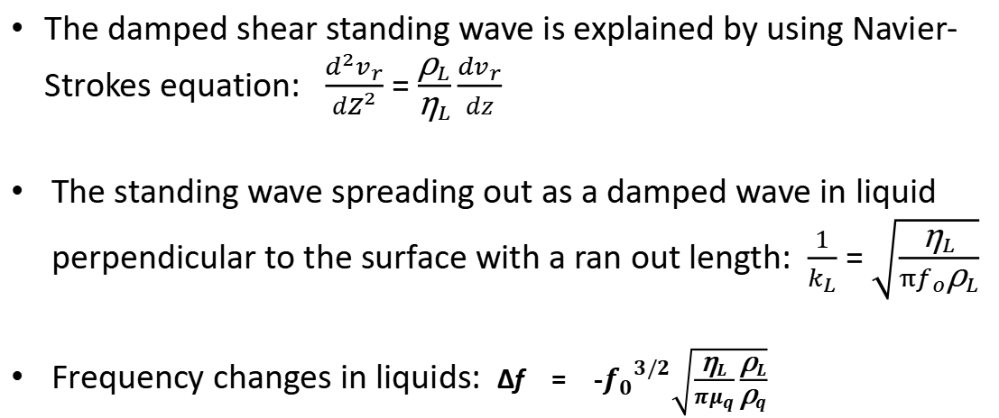
Mass deposition and sensitivity
What’s the Solution of damping in liquids?
The damped shear standing wave is explained by using Navier-Strokes equation: $\frac{d^{2}v_{r}}{dZ^{2}}$ = $\frac{{\text{ρ}}_{L}}{{\text{η}}_{L}}\frac{{dv}_{r}}{dz}$
The standing wave spreading out as a damped wave in liquid perpendicular to the surface with a ran out length: $\frac{1}{k_{L}}$ = $\sqrt{\frac{{\text{η}}_{L}}{{πf}_{o}{\text{ρ}}_{L}}}$
Frequency changes in liquids: ∆f = -${f_{0}}^{3/2}\sqrt{\frac{{\text{η}}_{L}}{{πμ}_{q}}\frac{{\text{ρ}}_{L}}{{\text{ρ}}_{q}}}$
Source: https://wiki.physik.fu-berlin.de/fp/_media/private:ma17.pdf

Slide 11
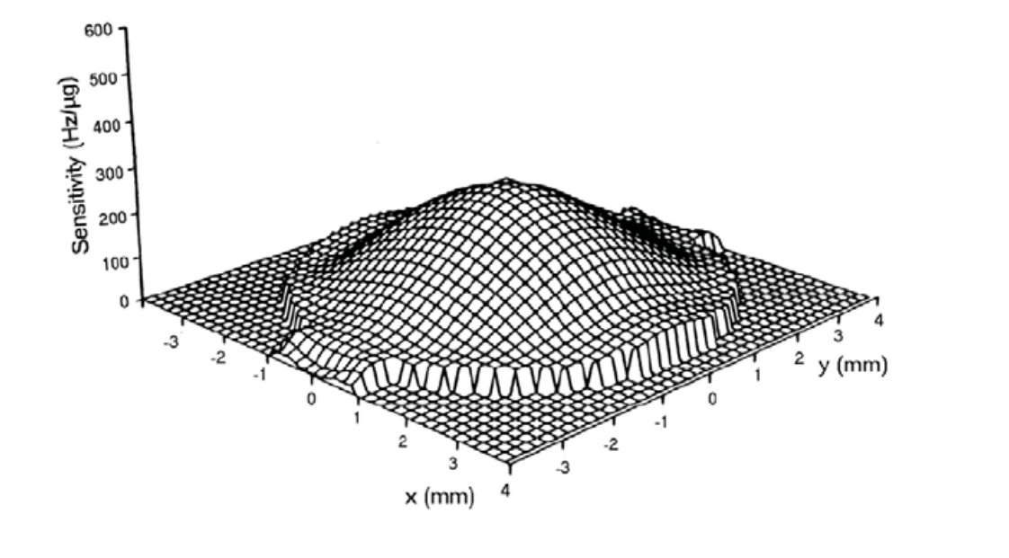
Mass sensitivity distribution of AT-cut qaurtz crystal
Source: https://wiki.physik.fu-berlin.de/fp/_media/private:ma17.pdf

Slide 12
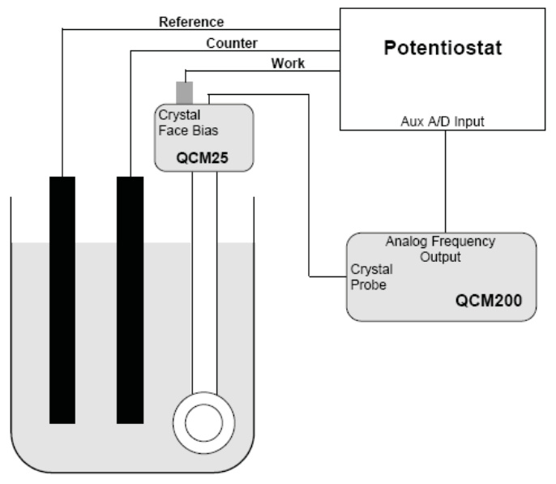
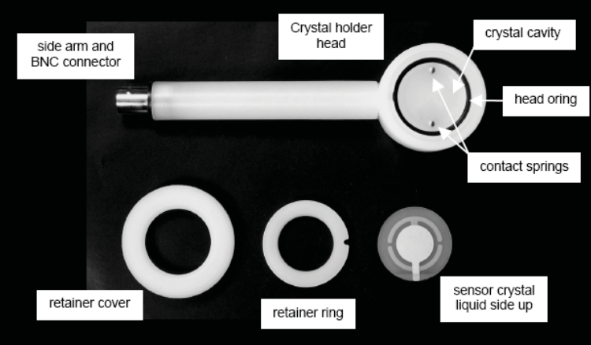
Experimental setup of QCM
The QCM consists of teflon holder for the Quartz, a potentiostat with three electrodes and digital interface for saving data
The Qaurtz crystal is inserted into the holder so that only one side touches the solution
Since the experiment is temperature sensitive, so the solution is tempered in a bath to have a constant temperature
Quartz crystal
Source: https://wiki.physik.fu-berlin.de/fp/_media/private:ma17.pdf

Slide 13

Measurement procedure of QCM
Initially the eigenfrequency is measured by applying an AC voltage to the crystal and comparing it with one obtained by Kanazawa and Gordon. Layer thickness can be calculated using this results
Secondly, the changes of frequency and binding with the quartz crystal is performed by adding 11-Marcaptundenatic acid in ethanol and cytochrome c respectively.
Lastly, cyclic voltammetry is done to test the activeness rate of cytochrome c on the crystal surface
Source: https://wiki.physik.fu-berlin.de/fp/_media/private:ma17.pdf

Slide 14

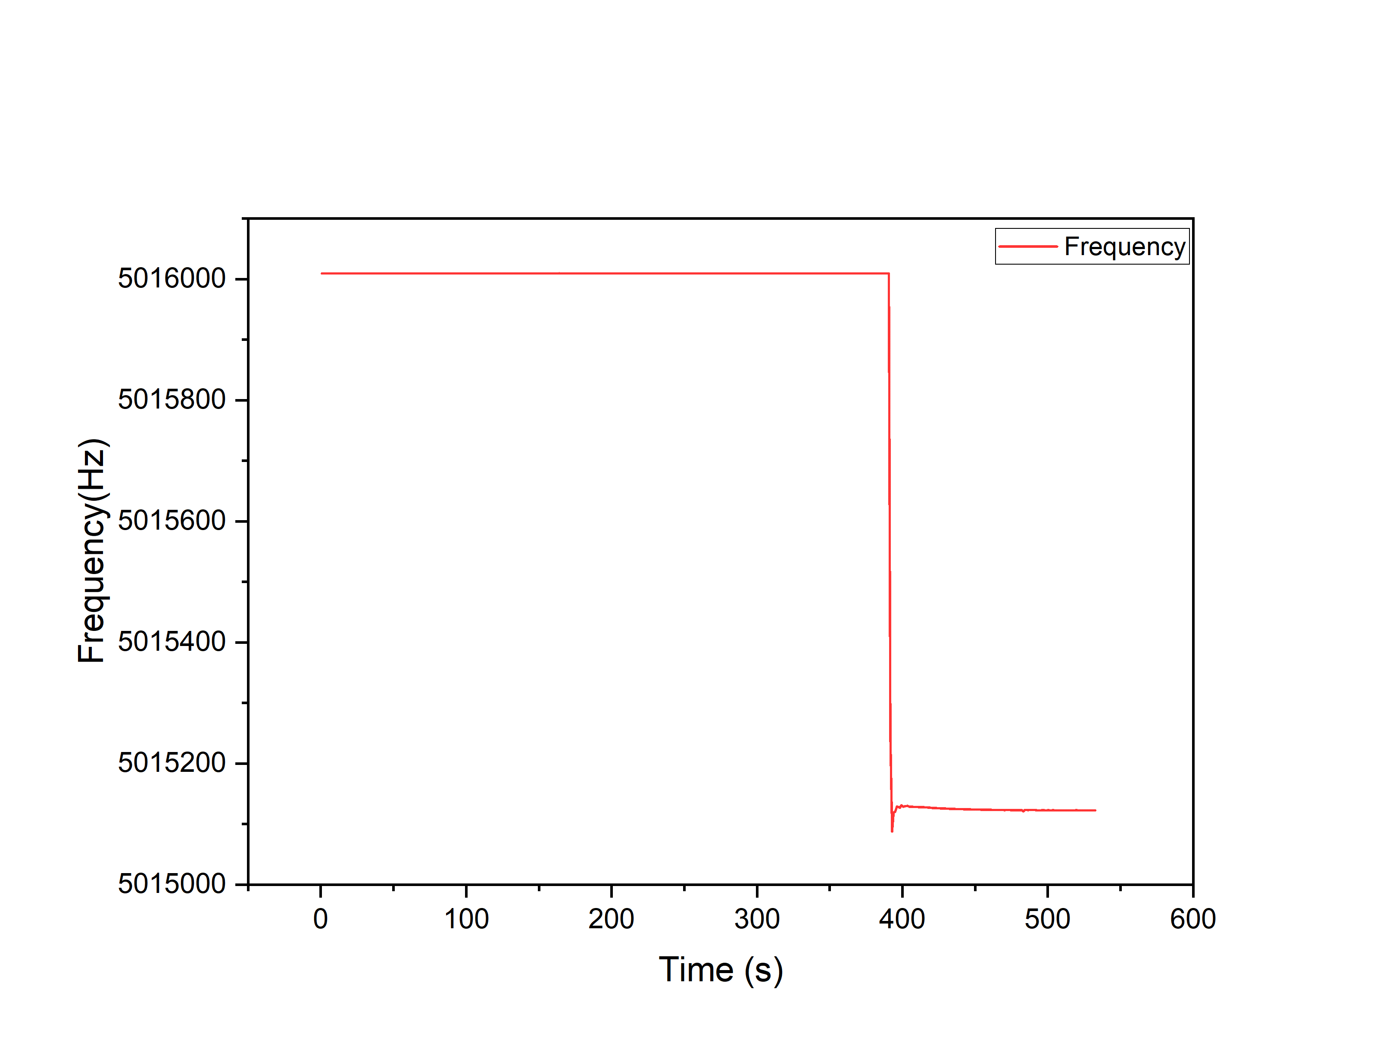
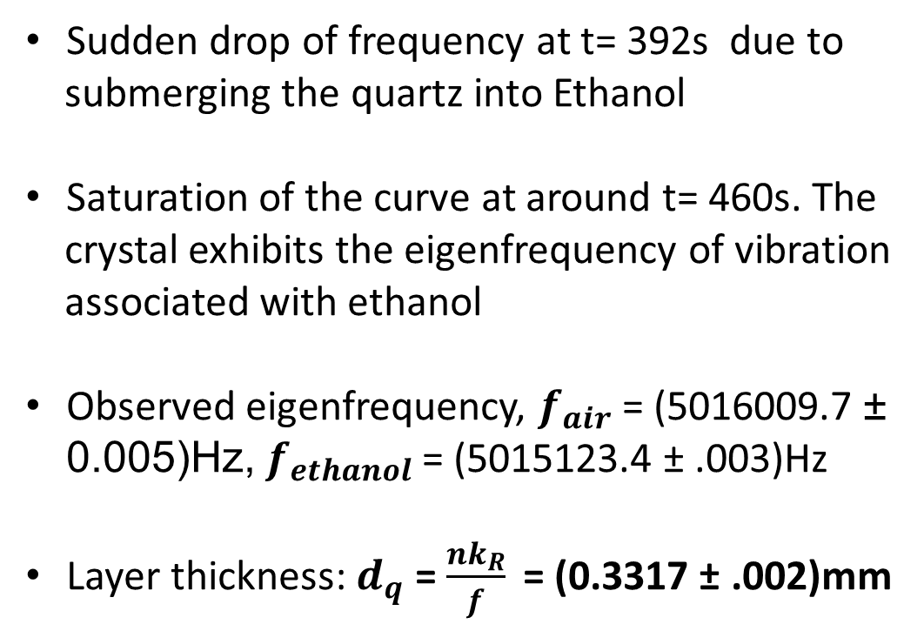
Data Analysis and Results
Eigenfrequency and layer thickness of the quartz crystal
Sudden drop of frequency at t= 392s due to
submerging the quartz into Ethanol
Saturation of the curve at around t= 460s. The
crystal exhibits the eigenfrequency of vibration
associated with ethanol
Observed eigenfrequency, $f_{air}$ = (5016009.7 ± 0.005)Hz,${ f}_{ethanol}$ = (5015123.4 ± .003)Hz
Layer thickness: $d_{q}$ = $\frac{{nk}_{R}}{f}$ = (0.3317 ± .002)mm

Slide 15
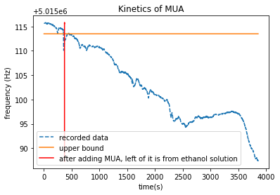
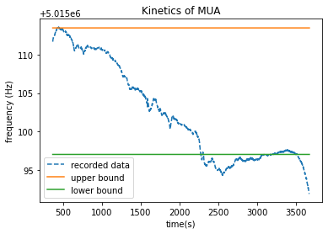
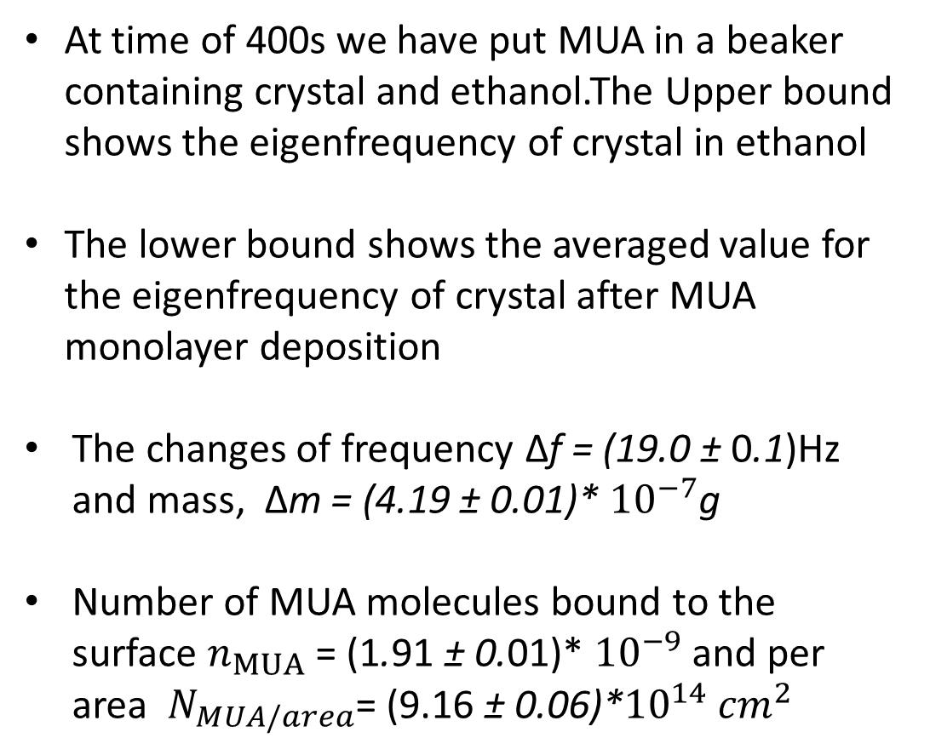
Binding of 11-Mercaptundecanic acid(MUA) on the crystal surface
At time of 400s we have put MUA in a beaker containing crystal and ethanol.The Upper bound shows the eigenfrequency of crystal in ethanol
The lower bound shows the averaged value for the eigenfrequency of crystal after MUA monolayer deposition
The changes of frequency ∆f = (19.0 ± 0.1)Hz and mass, ∆m = (4.19 ± 0.01)* ${10}^{−7}$g
Number of MUA molecules bound to the surface $n_{MUA}$ = (1.91 ± 0.01)* ${10}^{−9}$ and per area $N_{MUA/area}$= (9.16 ± 0.06)*${10}^{14}$ ${cm}^{2}$

Slide 16
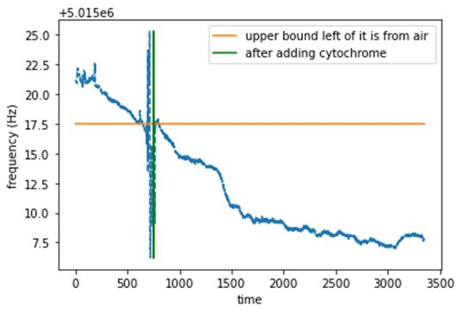
Cytochrome c binding with MUA monolayer
We put cytochrome in buffer solution containg Crystal with MUA molecules deposited on its surface at 750s
Because of the disturbance during time of adding the cytochrome we can see large fluctuations in graph
Then the frequency starts decreasing again as cytochrome starts binding with MUA layer

Slide 17
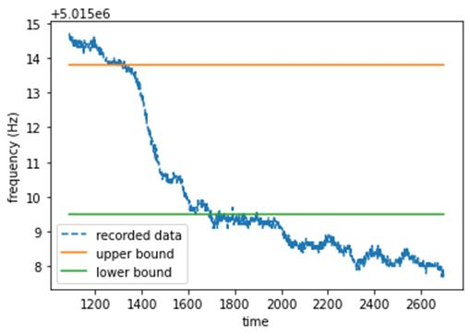
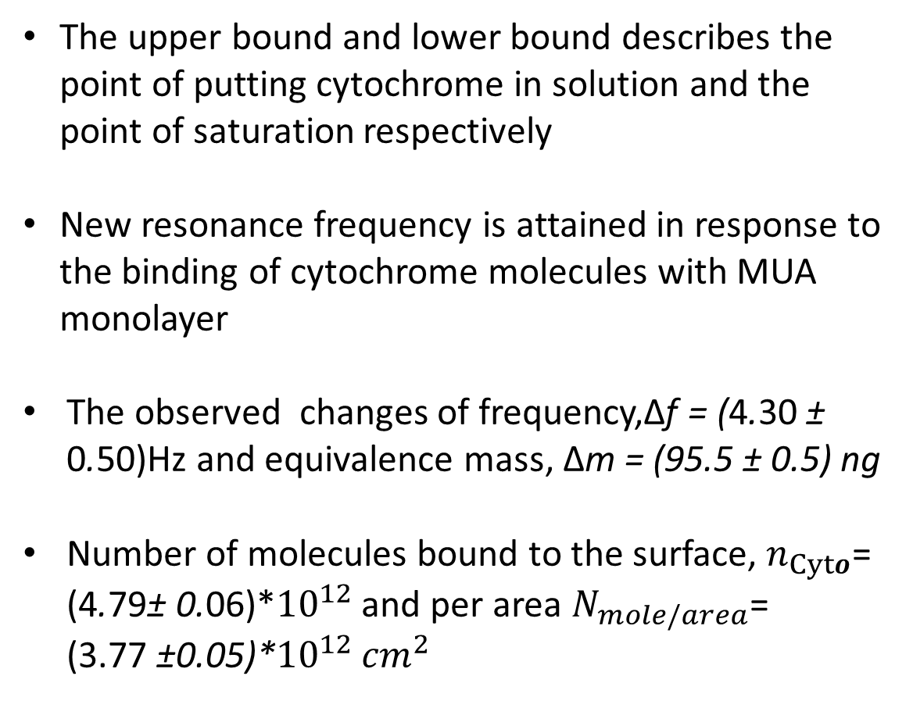
Cytochrome c binding with MUA monolayer
The upper bound and lower bound describes the point of putting cytochrome in solution and the point of saturation respectively
New resonance frequency is attained in response to the binding of cytochrome molecules with MUA monolayer
The observed changes of frequency,∆f = (4.30 ± 0.50)Hz and equivalence mass, ∆m = (95.5 ± 0.5) ng
Number of molecules bound to the surface, $n_{Cyto}$=
(4.79± 0.06)*${10}^{12}$ and per area $N_{mole/area}$=
(3.77 ±0.05)*${10}^{12}$ ${cm}^{2}$

Slide 18
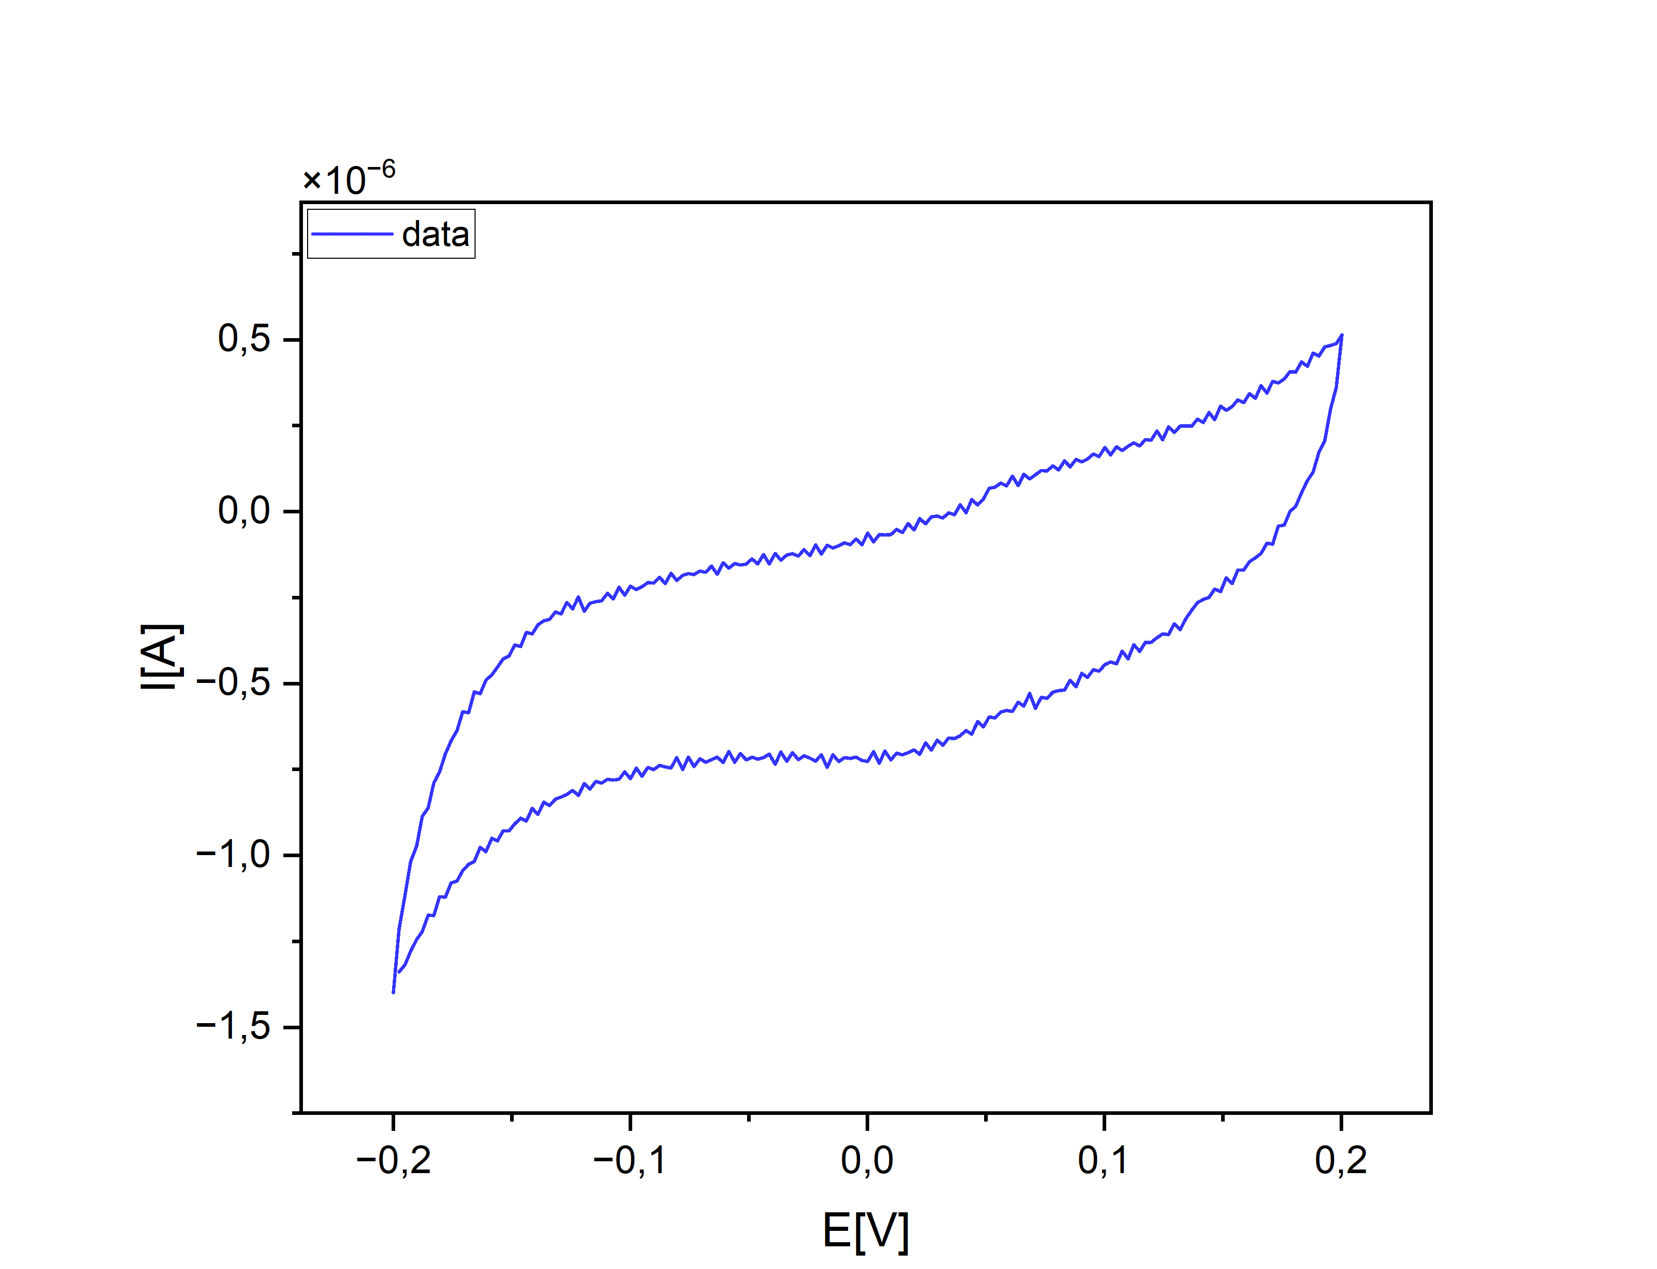
Cytochrome c binding with MUA monolayer
Cyclic Voltammetry is an electrochemical technique which is employed to study the oxidation and reduction processes of molecular species.
Till now our calculation is based on mass and frequency but now we want to find mass by process of reduction for this we need charge transfer which is done by voltameter.
By process of electron absorption which reduces the Fe3+ to Fe2+.
By this we find whether the cytochrome c is active and to the number of molecules bound on crystal as each cytochrome c contains one heme group

Slide 19
Applications of QCM
Biosensing and food analysis
Swelling, absorption and de-absorption rate
Rigidity, thickness and poly-electrode analysis
Multi-layer and it’s formation
Adhesivity and viscosity
Metal deposition
https://www.nanoscience.com/techniques/quartz-crystal-microbalance/, https://encyclopedia.pub/entry/18165

Slide 20
Thank you

